Slide 1
Predictive Modeling & Regression Analysis

Slide 2
Correlation& Karl Pearson’s Coefficient
Measures the degree of association between two variables
Two pieces of information
  The strength of relationship
  The direction of relationship
Simple coefficient of correlation:( Karl Pearson’s)

Slide 3
Types of Correlation
1 . Positive or Negative: If both the variables under study vary in the same direction i.e. if as one variable increases(decreases),the other ,on an average , also increases (decreases) correspondingly, then it’s a positive correlation e.g. rainfall and yields of a crop. If the variables vary in opposite directions then it’s a Negative Correlation. E.g. Price and demand for a commodity.
2. Simple, Partial and Multiple Correlation: When we study only two variables , it is a problem of simple correlation. In a multiple correlation, more than two variables are studied simultaneously. In partial correlation , we study more than two variables ,but consider only two variables at a time, treating the remaining as constants.

Slide 4
Features of
Correlation Coefficient, r
Unit free
Ranges between –1 and 1
The closer to –1, the stronger the negative linear relationship
The closer to 1, the stronger the positive linear relationship
The closer to 0, the weaker any positive linear relationship

Slide 5
Scatter Plots of Data with Various Correlation Coefficients
Y
Y
Y
X
X
X
r = -1
r = -.6
r = 0
Y
Y
Y
X
X
X
r = +1
r = +.3
r = 0

Slide 6
Regression
After finding a close correlation between two variables, we may be interested in estimating the value of one variable given the value of the other.
Regression Analysis is a statistical device used for estimating or predicting these unknown values of one variable ( called as dependent variable) from the known values of the other( called as independent variable).
This is accomplished through the regression line which describes the average relationship between the variables say x and y.

Slide 7
Scatter plots
Regression analysis requires interval and ratio-level data.
To see if your data fits the models of regression, it is wise to conduct a scatter plot analysis.
The reason?
  Regression analysis assumes a linear relationship. If you have a curvilinear relationship or no relationship, regression analysis is of little use.

Slide 8
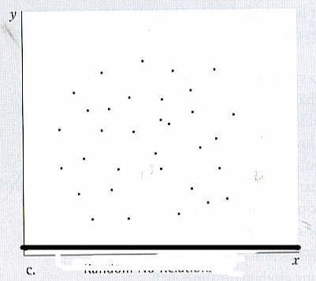
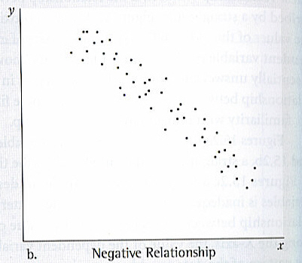
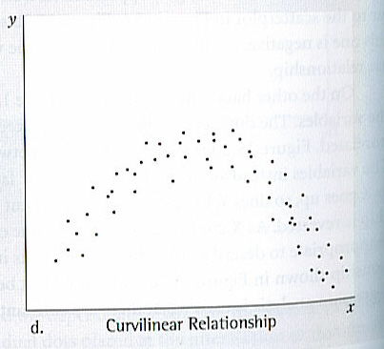
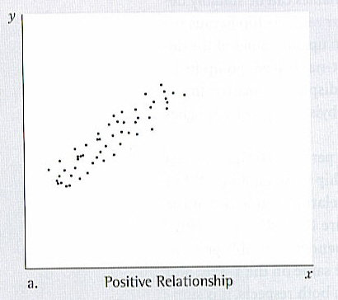
Types of Lines

Slide 9
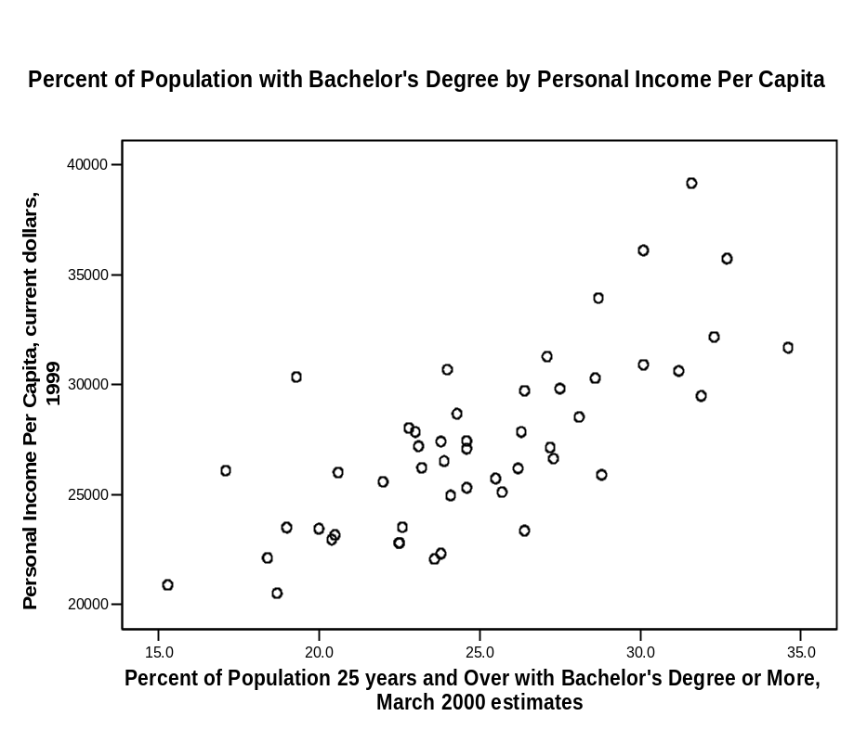
Scatter plot
This is a linear relationship
It is a positive relationship.
As population with BA’s increases so does the personal income per capita.

Slide 10
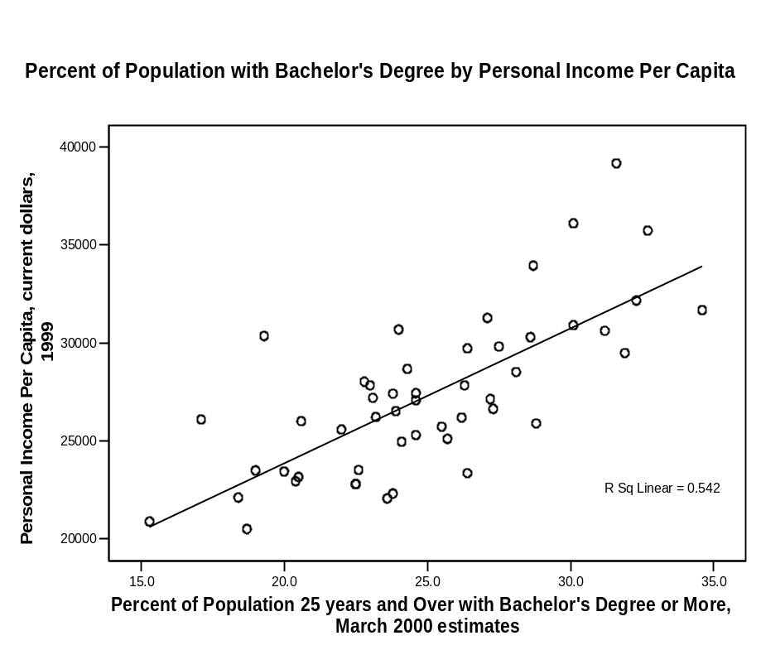
Regression Line
Regression line is the best straight line description of the plotted points and use can use it to describe the association between the variables.
If all the lines fall exactly on the line then the line is 0 and you have a perfect relationship.

Slide 11
Things to remember
Regressions are still focuses on association, not causation.
Association is a necessary prerequisite for inferring causation, but also:
  The independent variable must preceded the dependent variable in time.
  The two variables must be plausibly lined by a theory,
  Competing independent variables must be eliminated.

Slide 12
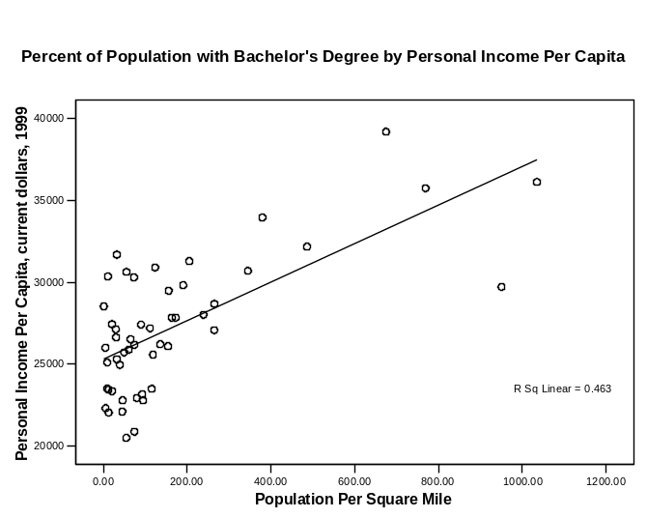
Regression Table
The regression coefficient is not a good indicator for the strength of the relationship.
Two scatter plots with very different dispersions could produce the same regression line.

Slide 13
Regression
Dependent variable
Independent variable (x)
Regression is the attempt to explain the variation in a dependent variable using the variation in independent variables.
Regression is thus an explanation of causation.
If the independent variable(s) sufficiently explain the variation in the dependent variable, the model can be used for prediction.

Slide 14

Simple Linear Regression Equation
Simple Linear Regression
y= a+ bx± є
є
Dependent variable (y)
b = slope
= ∆y/ ∆x
a (y intercept)
Independent variable (x)
The output of a regression is a function that predicts the dependent variable based upon values of the independent variables.
Simple regression fits a straight line to the data.

Slide 15
Simple Linear Regression
Observation: y
^
Prediction: y
Dependent variable
Zero
Independent variable (x)
The function will make a prediction for each observed data point.
The observation is denoted by y and the prediction is denoted by y.
^

Slide 16
Simple Linear Regression
Prediction error: ε
Observation: y
^
Prediction: y
Zero
For each observation, the variation can be described as:
y = y + ε
Actual = Explained + Error
^

Slide 17
Regression
Dependent variable
Independent variable (x)
A least squares regression selects the line with the lowest total sum of squared prediction errors.
This value is called the Sum of Squares of Error, or SSE.

Slide 18
Calculating SSR
Population mean: y
Dependent variable
Independent variable (x)
The Sum of Squares Regression (SSR) is the sum of the squared differences between the prediction for each observation and the population mean.

Slide 19
Regression Formulas
The Total Sum of Squares (SST) is equal to SSR + SSE.
Mathematically,
SSR = ∑ ( y – y ) (measure of explained variation)
SSE = ∑ ( y – y ) (measure of unexplained variation)
SST = SSR + SSE = ∑ ( y – y ) (measure of total variation in y)
^
2
^
2

Slide 20
The Coefficient of Determination
The proportion of total variation (SST) that is explained by the regression (SSR) is known as the Coefficient of Determination, and is often referred to as R .
R = =
The value of R can range between 0 and 1, and the higher its value the more accurate the regression model is. It is often referred to as a percentage.
2
2
SSR SSR SST SSR + SSE
2

Slide 21
Standard Error of Regression
The Standard Error of a regression is a measure of its variability. It can be used in a similar manner to standard deviation, allowing for prediction intervals.
y ± 2 standard errors will provide approximately 95% accuracy, and 3 standard errors will provide a 99% confidence interval.
Standard Error is calculated by taking the square root of the average prediction error.
√
SSE
n-k
Standard Error =
Where n is the number of observations in the sample and
k is the total number of variables in the model

Slide 22
The output of a simple regression is the coefficient β and the constant A. The equation is then:
y = A + β * x + ε
where ε is the residual error.
β is the per unit change in the dependent variable for each unit change in the independent variable. Mathematically:
β =
∆ y
∆ x

Slide 23
Multiple Linear Regression
More than one independent variable can be used to explain variance in the dependent variable, as long as they are not linearly related.
A multiple regression takes the form:
y = A + β X + β X + … + β k Xk + ε
where k is the number of variables, or parameters.
1 1 2 2

Slide 24
Multicollinearity
Multicollinearity is a condition in which at least 2 independent variables are highly linearly correlated. It will often crash computers.
Example table of Correlations
 |  | Y | X1 | X2
 | Y | 1.000
 | X1 | 0.802 | 1.000
 | X2 | 0.848 | 0.578 | 1.000
A correlations table can suggest which independent variables may be significant. Generally, an ind. variable that has more than a .3 correlation with the dependent variable and less than .7 with any other ind. variable can be included as a possible predictor.

Slide 25
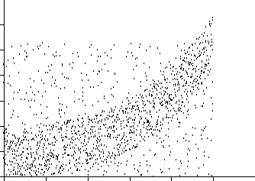
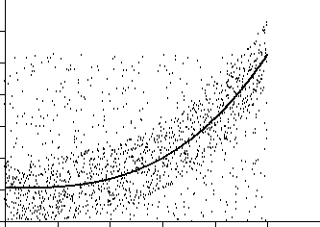
Nonlinear Regression
Nonlinear functions can also be fit as regressions. Common choices include Power, Logarithmic, Exponential, and Logistic, but any continuous function can be used.

Slide 26
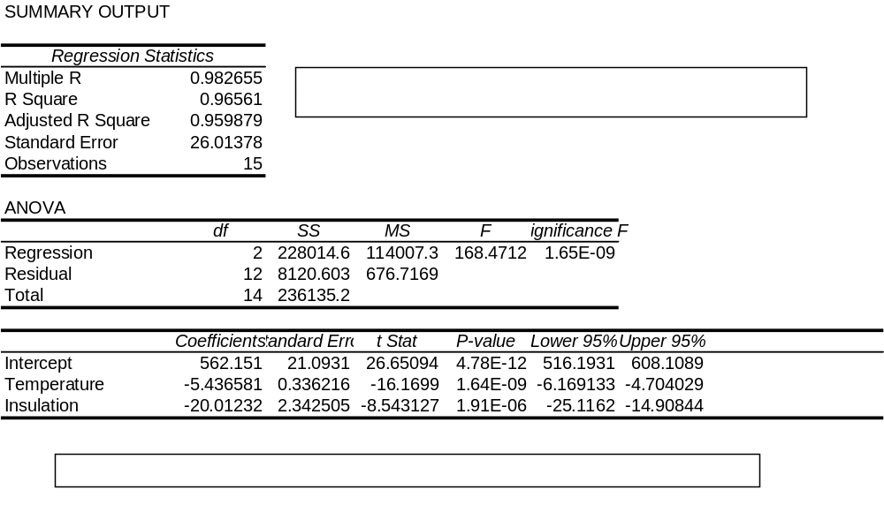
Regression Output in Excel

Slide 27
Regression coefficient
The regression coefficient is the slope of the regression line and tells you what the nature of the relationship between the variables is.
How much change in the independent variables is associated with how much change in the dependent variable.
The larger the regression coefficient the more change.

Slide 28
Pearson’s r
To determine strength you look at how closely the dots are clustered around the line. The more tightly the cases are clustered, the stronger the relationship, while the more distant, the weaker.
Pearson’s r is given a range of -1 to + 1 with 0 being no linear relationship at all.

Slide 29
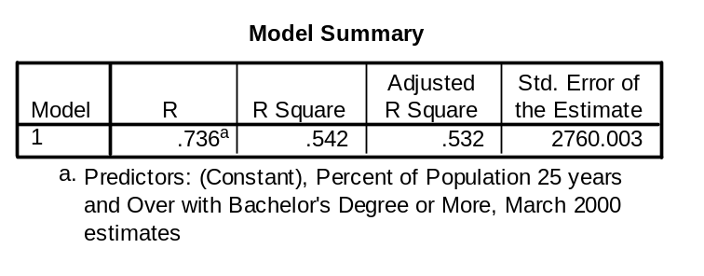
Reading the tables
When you run regression analysis on SPSS you get a 3 tables. Each tells you something about the relationship.
The first is the model summary.
The R is the Pearson Product Moment Correlation Coefficient.
In this case R is .736
R is the square root of R-Squared and is the correlation between the observed and predicted values of dependent variable.

Slide 30
R-Square
R-Square is the proportion of variance in the dependent variable (income per capita) which can be predicted from the independent variable (level of education).
This value indicates that 54.2% of the variance in income can be predicted from the variable education. Note that this is an overall measure of the strength of association, and does not reflect the extent to which any particular independent variable is associated with the dependent variable.
R-Square is also called the coefficient of determination.

Slide 31
Adjusted R-square
As predictors are added to the model, each predictor will explain some of the variance in the dependent variable simply due to chance.
One could continue to add predictors to the model which would continue to improve the ability of the predictors to explain the dependent variable, although some of this increase in R-square would be simply due to chance variation in that particular sample.
The adjusted R-square attempts to yield a more honest value to estimate the R-squared for the population. The value of R-square was .542, while the value of Adjusted R-square was .532. There isn’t much difference because we are dealing with only one variable.
When the number of observations is small and the number of predictors is large, there will be a much greater difference between R-square and adjusted R-square.
By contrast, when the number of observations is very large compared to the number of predictors, the value of R-square and adjusted R-square will be much closer.

Slide 32
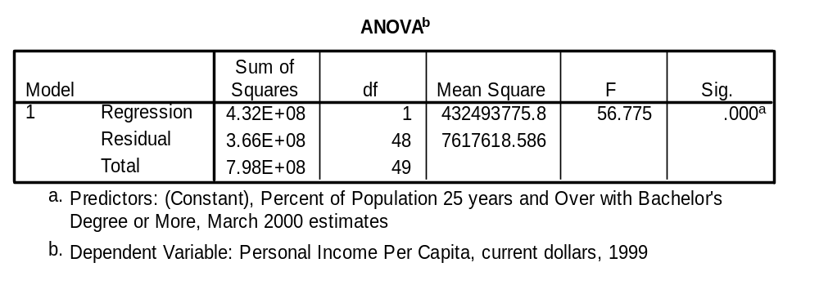
ANOVA
The p-value associated with this F value is very small (0.0000).
These values are used to answer the question "Do the independent variables reliably predict the dependent variable?".
The p-value is compared to your alpha level (typically 0.05) and, if smaller, you can conclude "Yes, the independent variables reliably predict the dependent variable".
If the p-value were greater than 0.05, you would say that the group of independent variables does not show a statistically significant relationship with the dependent variable, or that the group of independent variables does not reliably predict the dependent variable.

Slide 33
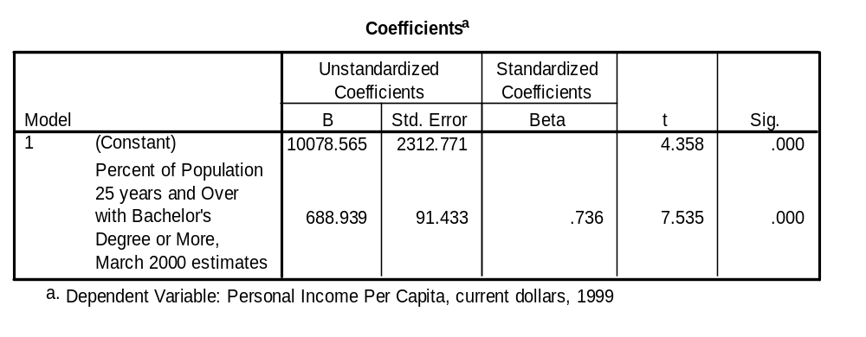
Coefficients
B - These are the values for the regression equation for predicting the dependent variable from the independent variable.
These are called unstandardized coefficients because they are measured in their natural units. As such, the coefficients cannot be compared with one another to determine which one is more influential in the model, because they can be measured on different scales.

Slide 34
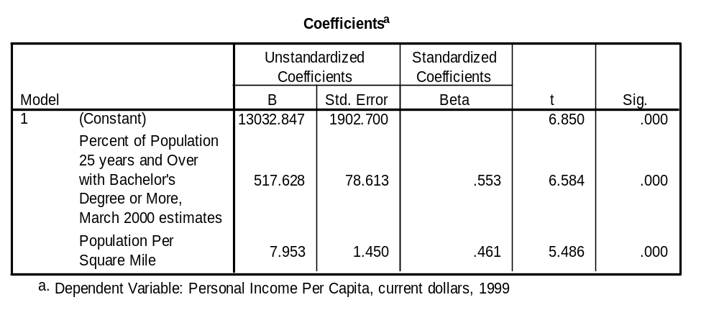
Coefficients
This chart looks at two variables and shows how the different bases affect the B value. That is why you need to look at the standardized Beta to see the differences.

Slide 35
Coefficients
Beta - The are the standardized coefficients.
These are the coefficients that you would obtain if you standardized all of the variables in the regression, including the dependent and all of the independent variables, and ran the regression.
By standardizing the variables before running the regression, you have put all of the variables on the same scale, and you can compare the magnitude of the coefficients to see which one has more of an effect.
You will also notice that the larger betas are associated with the larger t-values.

Slide 36
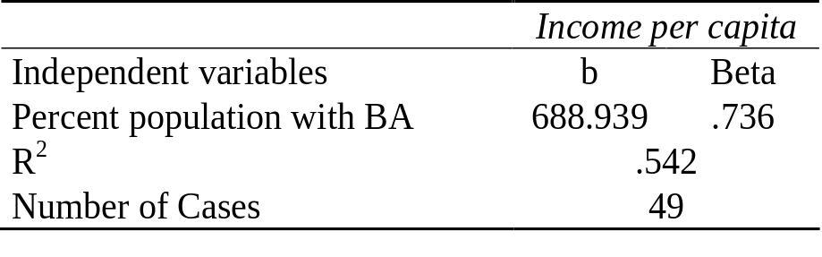
How to translate a typical table
Regression Analysis Level of Education by Income per capita

Slide 37
Part of the Regression Equation
b represents the slope of the line
  It is calculated by dividing the change in the dependent variable by the change in the independent variable.
  The difference between the actual value of Y and the calculated amount is called the residual.
  The represents how much error there is in the prediction of the regression equation for the y value of any individual case as a function of X.

Slide 38
Comparing two variables
Regression analysis is useful for comparing two variables to see whether controlling for other independent variable affects your model.
For the first independent variable, education, the argument is that a more educated populace will have higher-paying jobs, producing a higher level of per capita income in the state.
The second independent variable is included because we expect to find better-paying jobs, and therefore more opportunity for state residents to obtain them, in urban rather than rural areas.

Slide 39
H2 (a) There is a Significant impact of Awareness of Green Building on Intention to buy green building.(Regression Analysis)
Model | R | R Square | Adjusted R Square | Std. Error of the Estimate
1 | .779ª | .607 | .606 | .57685
a. Predictors: (Constant), Awareness of Green Building
ANOVA
Model |  | Sum of Squares | df | Mean Square | F | Sig.
1 | Regression | 278.795 | 1 | 278.795 | 837.841 | .000
 | Residual | 180.685 | 543 | .333
 | Total | 459.480 | 544
a. Dependent Variable: Intention to buy green building
b. Predictors: (Constant), Awareness of Green Building
The above table tells about model summary. R-square tells the “goodness of fit” of the model. R-square for this model is 0.607, which means that the independent variable, Awareness of Green Building is explaining 60.7% of the change in Intention to buy which is the dependent variable for this study. (p-value = .000< 0.05)

Slide 40
H2 (b) There is a Significant impact of Attitude towards Green building on Intention to buy green building.
Model Summary
Model | R | R Square | Adjusted R Square | Std. Error of the Estimate
1 | .817 | .667 | .666 | .53101
a. Predictors: (Constant), Attitude towards Green building
ANOVA
Model |  | Sum of Squares | df | Mean Square | F | Sig.
1 | Regression | 306.371 | 1 | 306.371 | 1086.545 | .000
 | Residual | 153.109 | 543 | .282
 | Total | 459.480 | 544
a. Dependent Variable: Intention to buy green building
b. Predictors: (Constant), Attitude towards Green building
The above table tells about model summary. R-square tells the “goodness of fit” of the model. R-square for this model is 0.607, which means that the independent variable, Attitude towards Green buildings explaining 66.7% of the change in Intention to buy which is the dependent variable for this study. Hence it is considered to be good model.

Slide 41
H2 (c) There is a significant impact of Perception towards Green Building on Intention to buy green building
Model Summary
Model | R | R Square | Adjusted R Square | Std. Error of the Estimate
1 | .781 | .609 | .609 | .57500
a. Predictors: (Constant), Perception towards Green Building
ANOVAª
Model |  | Sum of Squares | df | Mean Square | F | Sig.
1 | Regression | 279.948 | 1 | 279.948 | 846.715 | .000^{b}
 | Residual | 179.531 | 543 | .331
 | Total | 459.480 | 544
a. Dependent Variable: Intention to buy green building
b. Predictors: (Constant), Perception towards Green Building
In the above table, the R- square, also called the coefficient of determination is very useful. It measures the proportion of the total variation in Intention to buy green building about its mean explained by the regression of Intention to buy green building on Perception towards Green Building. In this case, the regression explains 60.9 % of the variation of Intention to buy green building is explained by Perception towards Green Building.

Slide 42
H2 (d) There is a significant impact of Cost of Green Building on Intention to buy green building
Model Summary
Model | R | R Square | Adjusted R Square | Std. Error of the Estimate
1 | .102ª | .010 | .009 | .91508
a. Predictors: (Constant), Cost of Green Building
ANOVAª
Model |  | Sum of Squares | df | Mean Square | F | Sig.
1 | Regression | 4.785 | 1 | 4.785 | 5.714 | .017^{b}
 | Residual | 454.695 | 543 | .837
 | Total | 459.480 | 544
a. Dependent Variable: Intention to buy green building
b. Predictors: (Constant), Cost of Green Building
In the above table, the R- square, also called the coefficient of determination is very useful. It measures the proportion of the total variation in Intention to buy green building about its mean explained by the regression of Intention to buy green building on Cost of Green Building. In this case, the regression explains 0.9 % of the variation of Intention to buy green building is explained by Perception towards Green Building.

Slide 43
H(e) There is a significant Rating system used by Green Building on Intention to buy green building
Model Summary
Model | R | R Square | Adjusted R Square | Std. Error of the Estimate
1 | .075a | .005 | .001 | .91932
a. Predictors: (Constant), Rating system used by Green Building
ANOVAª
Model |  | Sum of Squares | df | Mean Square | F | Sig.
1 | Regression | .563 | 1 | .563 | .666 | .415^{b}
 | Residual | 458.917 | 543 | .845
 | Total | 459.480 | 544
a. Dependent Variable: Intention to buy green building
b. Predictors: (Constant), Rating system used by Green Building
The above table tells about model summary. R-square tells the “goodness of fit” of the model. Adjusted R-square for this model is 0.001, which means that the independent variable, Rating system used by Green Building is explaining 0.1% of the change in Intention to buy which is the dependent variable for this study. Hence it is considered to be weak model.

Slide 44
H3. Awareness of Green Building, Attitude towards Green Building, Perceptions towards Green building, Cost of Green building and Rating System has an impact on Intention to buy green building.
(Stepwise Regression Analysis)
Table No 110 Model Summary
Model | R | R Square | Adjusted R Square | Std. Error of the Estimate
1 | .817ª | .667 | .666 | .53101
2 | .832^{b} | .692 | .691 | .51121
3 | .834^{c} | .696 | .694 | .50813
ANOVAª
Model |  | Sum of Squares | df | Mean Square | F | Sig.
1 | Regression | 306.371 | 1 | 306.371 | 1086.545 | .000^{b}
 | Residual | 153.109 | 543 | .282
 | Total | 459.480 | 544
2 | Regression | 317.833 | 2 | 158.917 | 608.082 | .000^{c}
 | Residual | 141.647 | 542 | .261
 | Total | 459.480 | 544
3 | Regression | 319.794 | 3 | 106.598 | 412.853 | .000^{d}
 | Residual | 139.685 | 541 | .258
 | Total | 459.480 | 544
a. Dependent Variable: Intention to buy green building

Slide 45
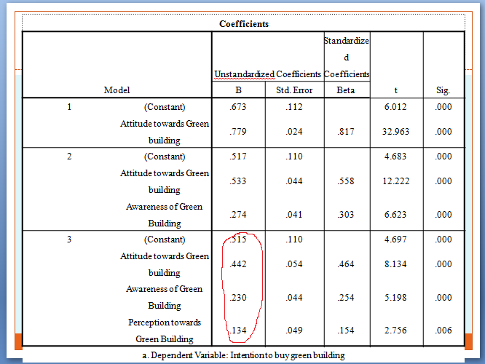

Slide 46
Interpretation
In the next section, we will discuss the interpretation of unstandardized and standardized coefficient in linear regression.
Linear Regression : Unstandardized Coefficient
It represents the amount by which dependent variable changes if we change independent variable by one unit keeping other independent variables constant.
Linear Regression : Standardized Coefficient
The standardized coefficient is measured in units of standard deviation. A beta value of 1.25 indicates that a change of one standard deviation in the independent variable results in a 1.25 standard deviations increase in the dependent variable.

Slide 47
From the Model Summary table it can be seen that the Stepwise Multiple Regression (SMR) model has produce three Regression Models.
Model: 01 Predictor- Attitude towards Green building
R² ⁼ 0.667
Model 01 includes the most meritorious predictor Attitude towards Green building. Attitude towards Green building can explain 66.7% of variance of Dependent Variable (DV) Intention to buy green building.
Model: 02 Predictors - Attitude towards Green building and Awareness of Green Building
R² ⁼ 0.692
R Square Change=0.025
Model: 02 include Attitude towards Green building and Awareness of Green Building.
The Attitude towards Green building and Awareness of Green Building can explain 69.2% of the variance Dependent Variable (DV) Intention to buy green buildings. The inclusion of awareness of Green Building to model improves the predictive ability of the model by 2.5%.
This improvement is significant at 5% level of significance.
F (2,544) = 608.082, p=0.000.
Model: 03: Predictors- Attitudes, awareness and Perception towards Green Building.
R² ⁼ 0.696
This Includes Attitude towards Green building, Awareness of Green Building, Perception towards Green Building 69.6% of the variance Dependent Variable (DV) Intention to buy green building. The inclusion of Perception towards Green Building to model improves the predictive ability of the model by 0.4%.
This improvement is significant at 5% level of significance.
F (3,544) = 412.853, p=0.000.
Hence, it can be concluded that null hypothesis is rejected and alternative hypothesis is accepted i.e. One of the Independent Variables (IDVs) Awareness of Green Building, Attitude towards Green Building, Perceptions towards Green building, Cost of Green building and Rating System has an impact on Intention to buy green building.

Slide 48
From the Coefficient Table it can be seen that
a) Attitude towards Green building) has a positive impact on predictor of Intention to buy green building, (B = 0.442, t = 8.134, p = 0.000).
b) Awareness of Green Building has a positive impact on Intention to buy green building, (B = 0.230, t = 5.198, p = 0.000).
c) Perception towards Green Building has a positive impact on predictor of Intention to buy green building, ( B = 0.134 ,t = 2.756, p = 0.006).
Hence the Stepwise Multiple Regression Model can be presented as follows:
Intention to buy green building = 0.515 + 0.442 (Attitude towards Green building) + 0.230 (Awareness of Green Building) + 0.134 (Perception towards Green Building).
Y = a+bx1+bx2+bx3

Slide 49
H4. There is a significant impact of internal factors on Business opportunities for eco- friendly buildings (Regression Analysis)
Model | R | R Square | Adjusted R Square | Std. Error of the Estimate
1 | .527ª | .277 | .266 | .15059
a. Predictors: (Constant), Internal Factor
b. Dependent Variable: Business Opportunities
ANOVAª
Model |  | Sum of Squares | df | Mean Square | F | Sig.
1 | Regression | .566 | 1 | .566 | 24.960 | .000^{b}
 | Residual | 1.474 | 65 | .023
 | Total | 2.040 | 66
a. Dependent Variable: Business Opportunities
b. Predictors: (Constant), Internal Factor
The above table tells about model summary. R-square tells the “goodness of fit” of the model. R-square for this model is 0.266, which means that the independent variable, internal factors is explaining 26.6% of the change in business opportunities in green building which is the dependent variable for this study.

Slide 50
H5: There is a significant impact of External Factors on the Business opportunities of Green building.(Regression Analysis)
Table No. 116 Model Summary
Model | R | R Square | Adjusted R Square | Std. Error of the Estimate
1 | .841ª | .708 | .689 | .09809
a. Predictors: (Constant), Political, Technological, Economical, Social
ANOVAª
Model |  | Sum of Squares | df | Mean Square | F | Sig.
1 | Regression | 1.443 | 4 | .361 | 37.499 | .000^{b}
 | Residual | .597 | 62 | .010
 | Total | 2.040 | 66
a. Dependent Variable: Business Opportunities
b. Predictors: (Constant), Political, Technological, Economical, Social
The above table tells about model summary. R-square tells the “goodness of fit” of the model. R-square for this model is 0.689, which means that the independent variable, External factors is explaining 68.9% of the change in business opportunities in green building which is the dependent variable for this study.

Slide 51
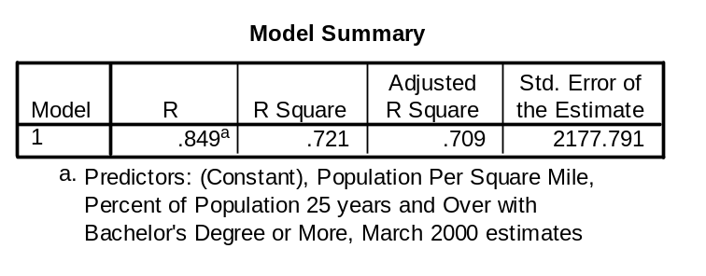
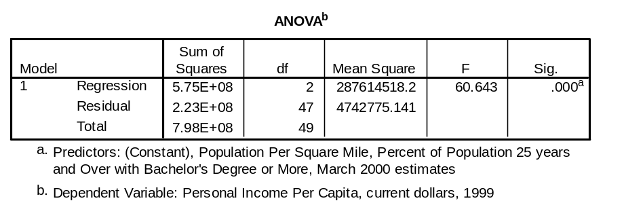
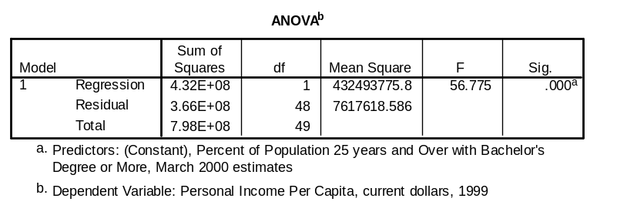


Single
Multiple Regression

Slide 52
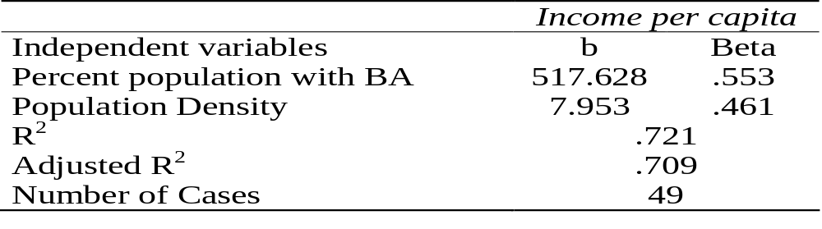
Single Regression
Multiple Regression

Slide 53
Questions
Q1. A bank developed a model for predicting the average checking and saving account balance as
Balance = -17.732 +367 x Age + 1300 x years education + 0.116 x household wealth
Explain how to interpret the numbers in this model.
Suppose that a customer is 32 years old, is a college graduate (so that years education =16), and has household wealth of Rs 150000. What is the predicted bank balance?

